Slide 1
Smart Contracts
1. What is a Smart Contract? How do smart contracts differ from traditional paper-based contracts in terms of structure, execution, and trust?
A smart contract is a self-executing digital contract stored on a Blockchain that automatically enforces the terms and conditions of an agreement when predetermined conditions are met.
Traditional paper-based contracts: Is a system that requires manual processing which can be time consuming and rely on physical documents like receipts, invoices and contracts.

Slide 2
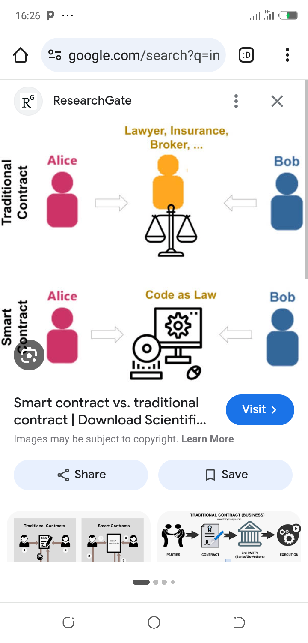
Smart Contracts and Traditional paper-based contract

Slide 3
Smart Contracts
How do smart contracts differ from traditional paper-based contracts in terms of structure, execution, and trust?
- Structure: traditional paper-based are written in natural language while Smart written in code, making them machine-readable and executable.
- Execution: traditional require manual interpretation Smart contracts Automated execution when conditions are met, eliminating the need for intermediaries.
- Trust: smart contracts are Built-in trust mechanism through Blockchain technology, ensuring transparency, immutability, and tamper-proofing while paper-based rely on repudiation and credibility of parties.

Slide 4
Qn 2. How Does Blockchain Enable Smart Contracts?
Blockchain technology, such as Ethereum, provides a decentralized, secure, and transparent foundation for running smart contracts.
Key features include :
- Decentralized network: Ensures that smart contracts are executed on a network of nodes, rather than a single central authority.
- Immutable ledger: Records all transactions and smart contract executions, providing a permanent and tamper-proof record.
- Smart contract execution: Allows for the creation and execution of complex logic and rules.

Slide 5
Qn 3. How Do Smart Contracts Work Technically?
Smart contracts technically use the "if/when...then..." principle to define rules and actions. When conditions are met, the smart contract executes the corresponding action. For example:
- IF a payment is made, THEN transfer ownership of an asset.
- The Blockchain records all transactions and smart contract executions, ensuring transparency and immutability.

Slide 6
Qn 4. How Do Smart Contracts Eliminate the Need for Intermediaries?
Smart contracts automate the execution of agreements, eliminating the need for intermediaries like lawyers, brokers, or banks. This builds trust between parties by:
- Automating execution: Ensuring that agreements are executed as programmed.
- Providing transparency: Allowing parties to track the execution of agreements.
- Ensuring immutability: Preventing changes to the agreement once it's been deployed.

Slide 7
Qn 5. How Are Smart Contracts Created and Deployed?
Smart contracts are created using programming languages like Vyper, Rust and Solidity (for Ethereum) and deployed on a blockchain network. The process involves :
- Writing the contract: Coding the smart contract using a programming language.
- Compiling the contract: Converting the code into machine-readable format.
- Deploying the contract: Uploading the compiled contract to a blockchain network.

Slide 8
Qn 6. What Are the Key Advantages and Limitations/Risks of Smart Contracts?
Advantages:
- Speed: Fast execution of agreements.
- Efficiency: Automation eliminates intermediaries.
- Transparency: All transactions are recorded on a public ledger.
- Security: Immutable and tamper-proof.

Slide 9
Qn 6. What Are the Key Advantages and Limitations/Risks of Smart Contracts?
Limitations/Risks:
- Complexity: Smart contracts can be complex and difficult to understand.
- Regulatory uncertainty: Lack of clear regulations and laws governing smart contracts.
- Security risks: Vulnerabilities in smart contract code can lead to security breaches.

Slide 10
Qn 7. In Which Real-World Sectors are Smart Contracts Used?
Smart contracts are used in various sectors, including:
- Finance: Automating financial transactions and agreements.
- Supply Chain: Tracking and verifying the movement of goods.
-Healthcare: Securely managing patient data and medical records.
Examples:
- The Home Depot: Using smart contracts to automate vendor payments and dispute resolution.
- Arbol: Using smart contracts to create parametric insurance based on weather data .

Slide 11
Qn 8. Which Cryptocurrencies and Platforms Support Smart Contracts?
Some popular platforms that support smart contracts include:
- Ethereum: A decentralized platform for building and executing smart contracts.
- Cardano: A blockchain platform for building and executing smart contracts.
- Solana: A fast and scalable blockchain platform for building and executing smart contracts.
- Binance Smart Chain: A blockchain platform that supports the creation and execution of smart contracts.

Slide 12


Slide 13
References
Buterin, V. (2014). Ethereum: A next-generation smart contract and decentralized application platform.
Szabo, N. (1994). Smart contracts: Building blocks of a new society.
Antonopoulos, A. M., & Wood, G. (2018). Mastering Ethereum: Building smart contracts and DApps. O'Reilly Media.
The Home Depot. (n.d.). Case study: The Home Depot.
Arbol. (n.d.). Case study: Arbol.
Binance. (n.d.). Binance Smart Chain documentation.
Ethereum. (n.d.). Ethereum documentation.

